Slide 1
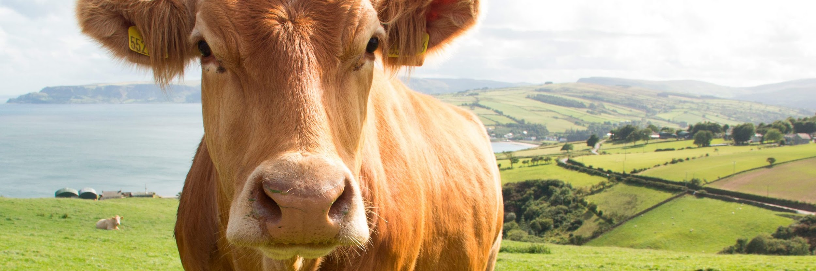

IMAGE COMPRESSION ALGORITHMS FOR PROCESS OPTIMIZATION IN LIVESTOCK FARMING
PRECISION

Slide 2


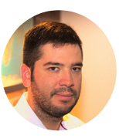





Team Presentation
Stefanny Escobar Ramírez
Sara Gallego
David González
Simón Marín
Mauricio
Toro
https://github.com/StefannyEscobar/FarmingProject.git

Slide 3
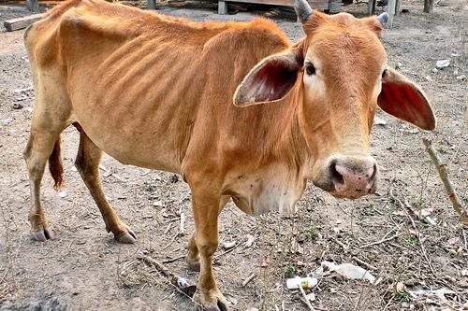
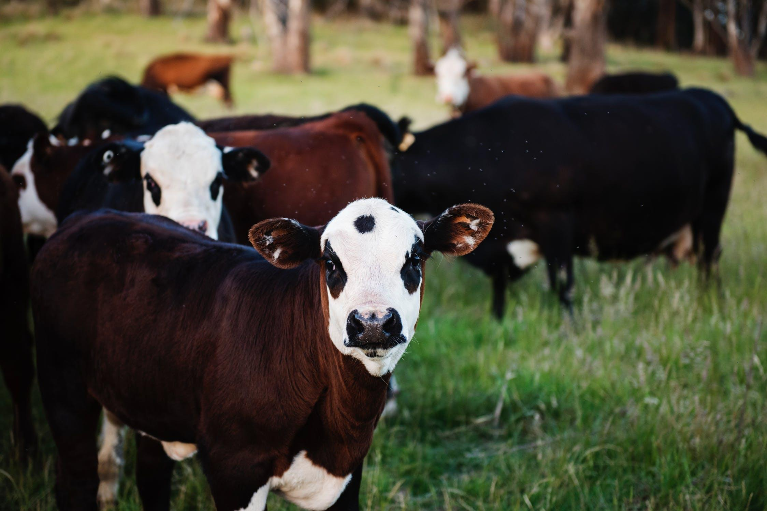
Training Process
Convolutional Neural Network
Sick-Cattle Images
Classification Algorithm
Classification Model
Healthy-Cattle Images

Slide 4
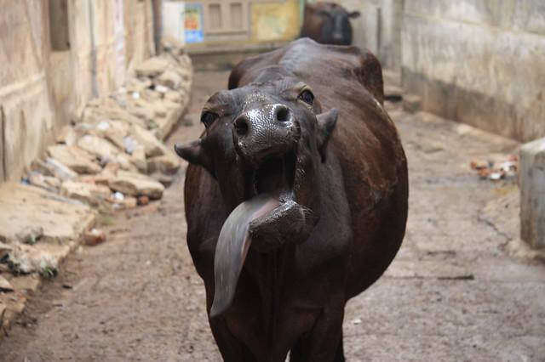
Testing Process
???
Is sick
Cattle Image
Huffman coding
Classification Model
Output

Slide 5
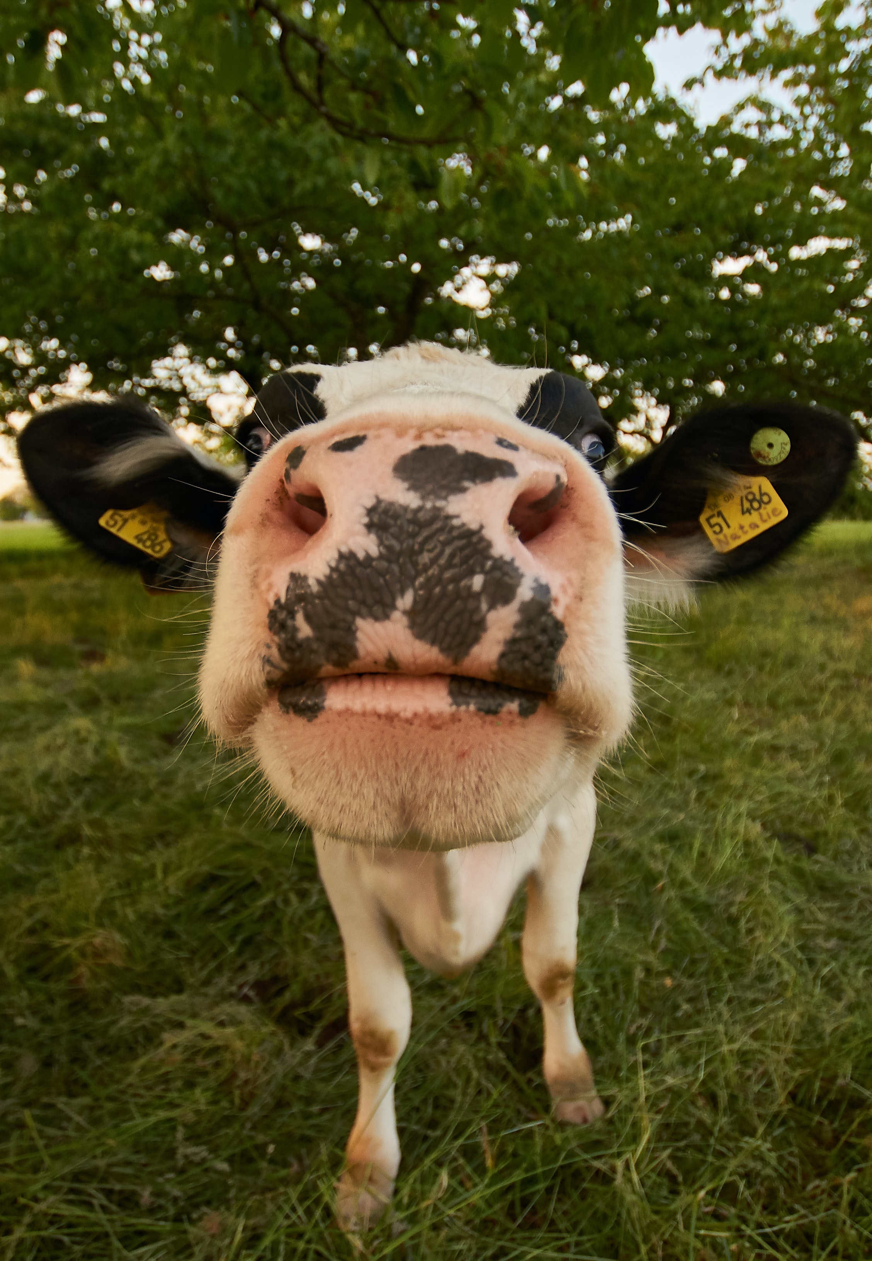
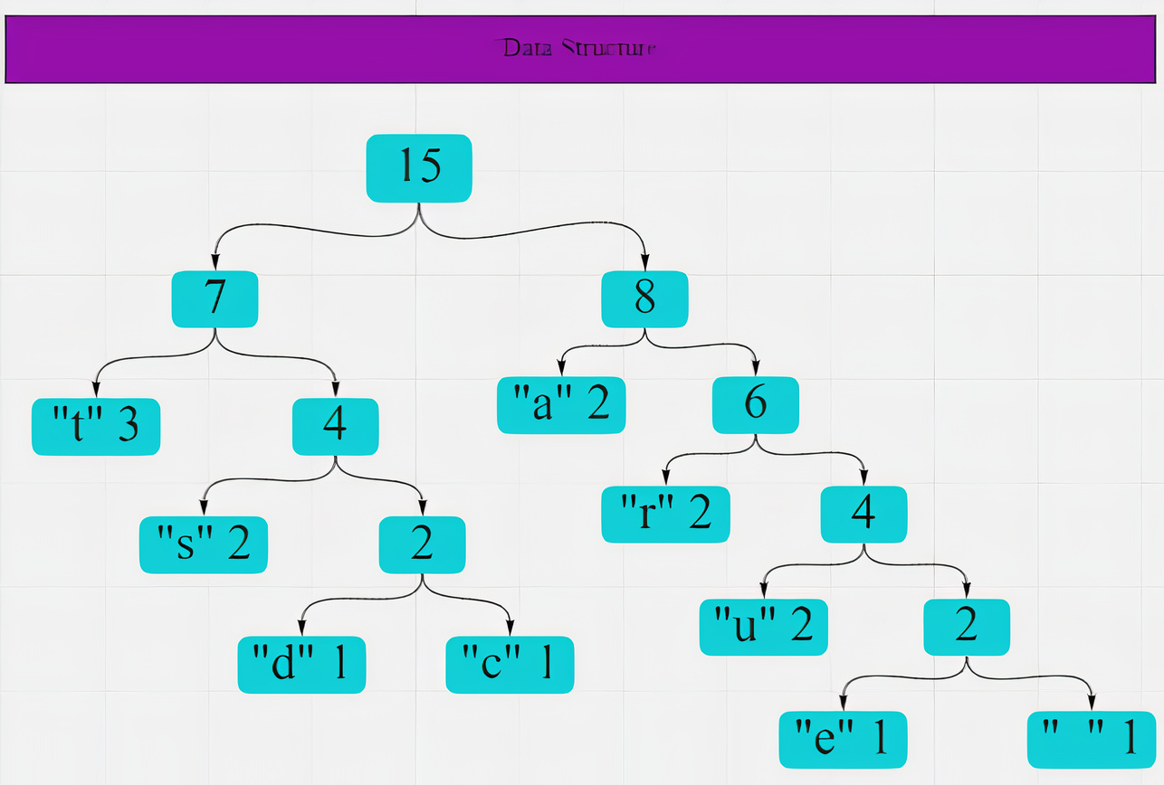
Compression Algorithm Design: Huffman Coding
Photo by Wolfgang Hasselmann on Unsplash
The binary tree is a data structure which is composed of root, branch and leaf, in which each node can have one left and one right child.

Slide 6
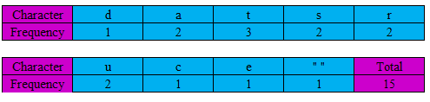
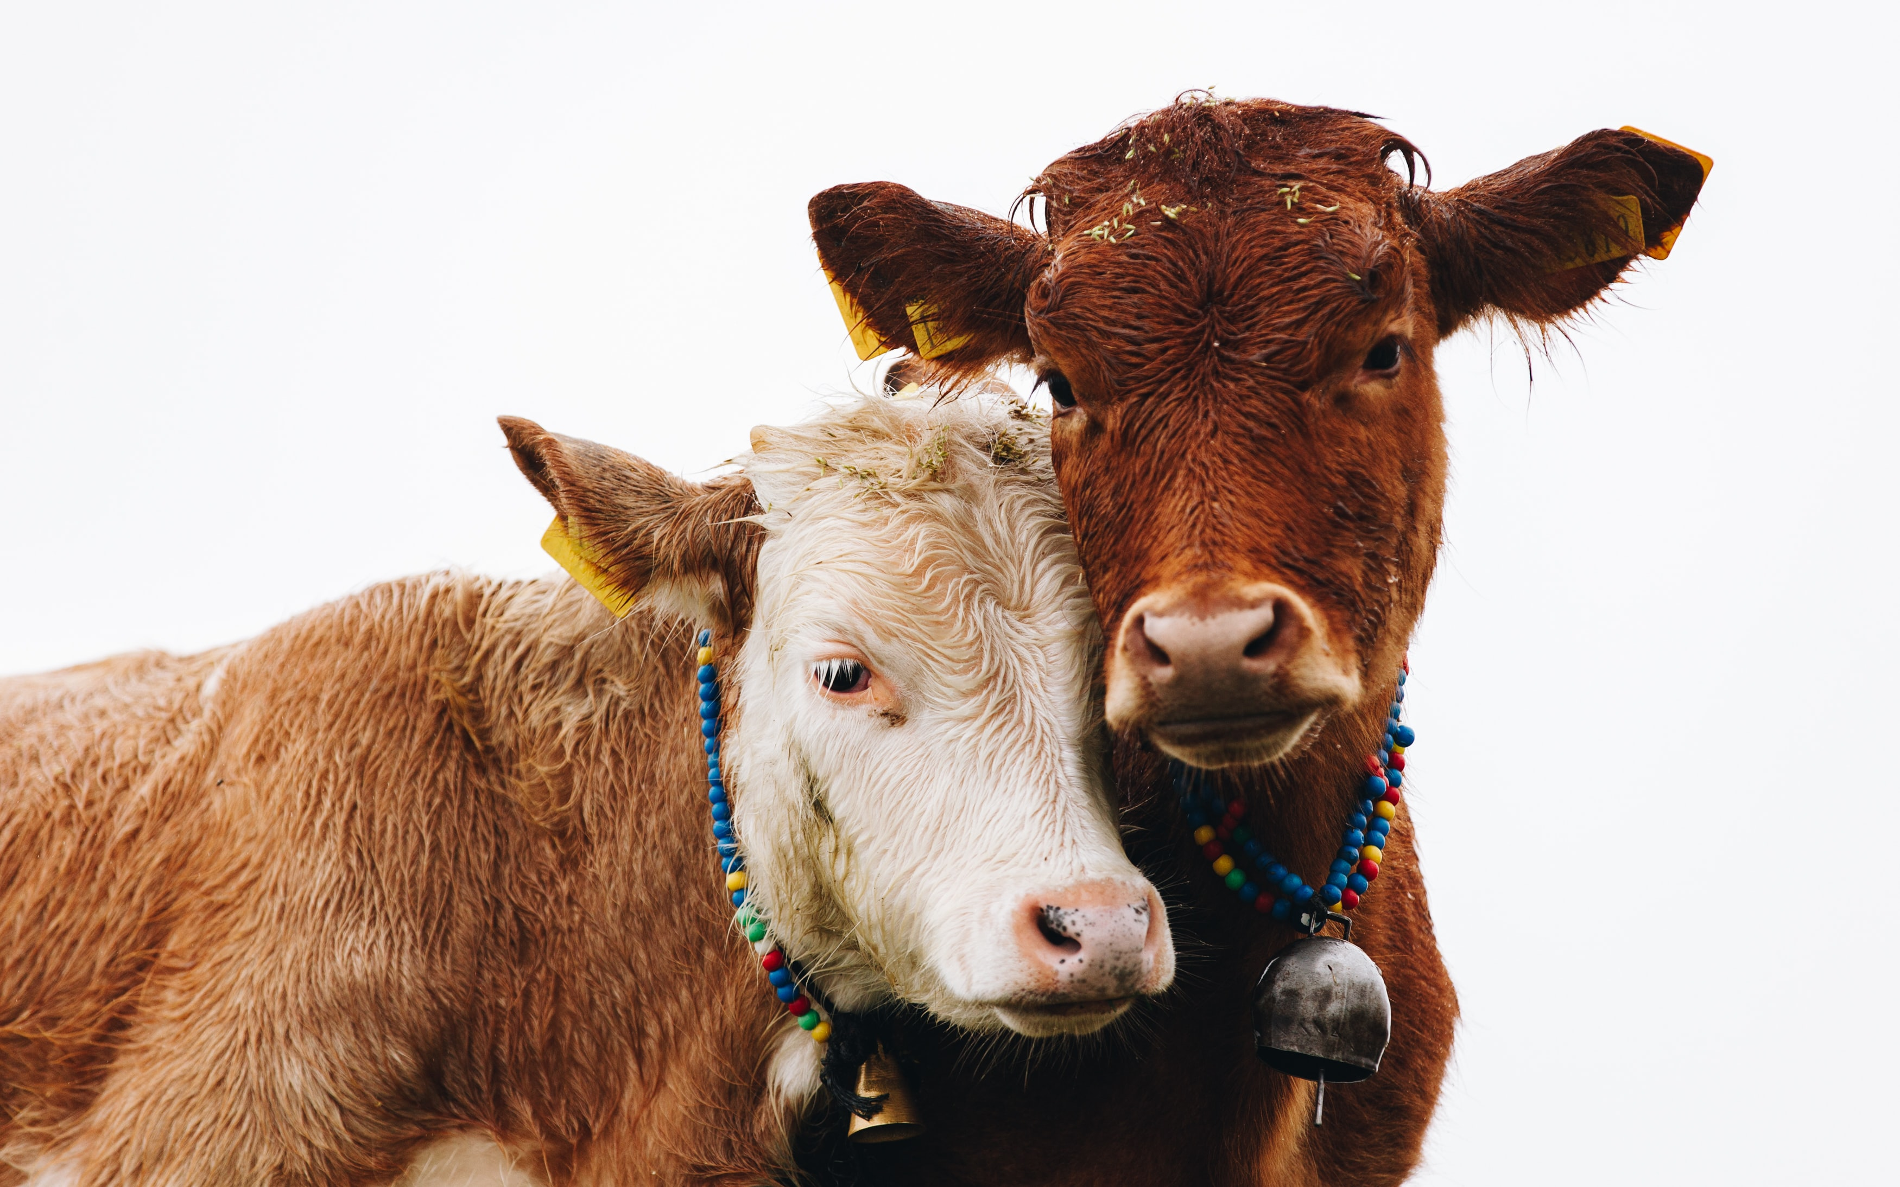
Compression Algorithm Design: Huffman Coding
Huffman Tree from the string “Data Structure”
Photo by Doruk Yemenici on Unsplash
Huffman coding is implemented by constructing a binary tree of nodes from a list of nodes, whose size depends on the number of symbols n. The nodes contain two fields, the symbol and the weight.

Slide 7
Thanks!.
Supported by
The two author is supported by a Sapiencia grant funded by the municipality of Medellín. The other author are supported by Generation E. All authors would like to thank the Vicerrectoría de Descubrimiento y Creación, Universidad EAFIT, for their support in this research.

